Slide 1
IST 210
Organization of Data
Relational Schema Example
Dr. S. Gokhan Ozden
gokhan@psu.edu

Slide 2
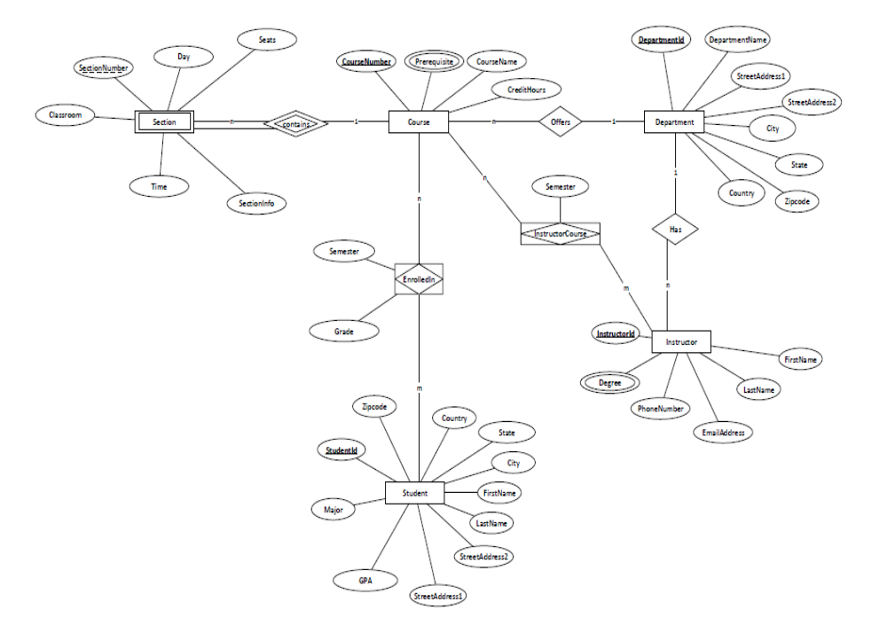

Slide 3
Exercise 1
Convert ER Diagram into a relational schema
Use Stable and Mapped Translation methods

Slide 4
Exercise 2
Create tables for these relational schema in your word document and populate some dummy data
CourseNumber, SectionNumber should be 3 characters string
StudentID should be a 9 digit string in this format (XXXXXXXXX)
InstructorID should be a 9 digit string in this format (XXXXXXXXX)
DepartmentID can be simple integer starting with 1

